Slide 1
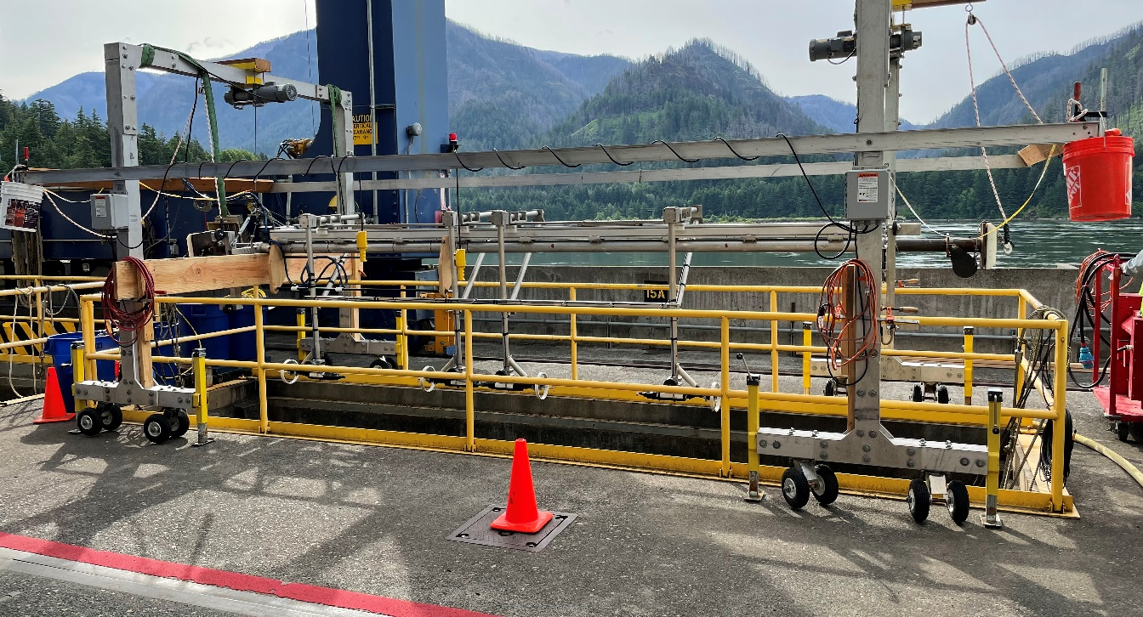
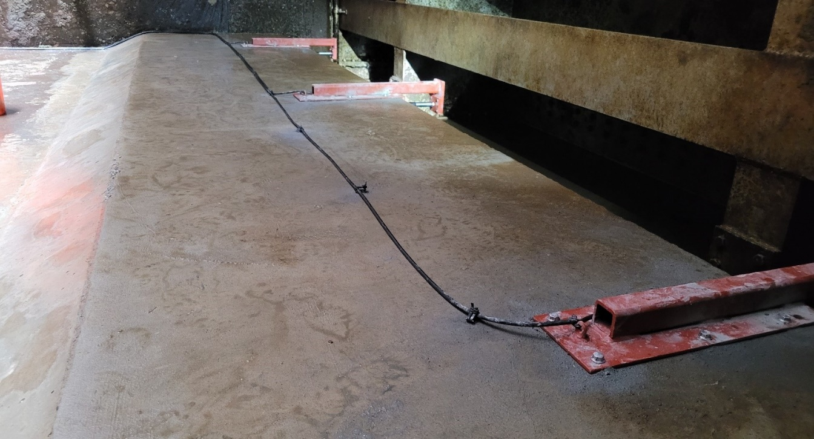
FFDRWG: B2FGE Hydraulic testing results & Path forward
PM: Jim Adams
TL: Max Wilson-Fey
FC: Jon Rerecich
USACE-NWP
03 November 2022

Slide 2
Outline
Background
Hydraulic Testing Conclusions
Additional Considerations
Path Forward
Schedule

Slide 3
background
Steel plates were installed in all BON PH2 units in the A and B headgate slot to restrict flow in the gatewells to improve passage conditions for juvenile fish. Routine inspections determined the anchoring system for the steel plates were inadequate. All steel plates were removed from the units out of concern that the plates could detach and potentially damage a unit. Since then, BPA has been constrained to operate PH2 units at the middle 1% peak efficiency flows.
Concrete corbels have been installed in Unit 15 (Slots A and B) in place of the steel plates. The design goal is to achieve similar gatewell hydraulic conditions as the steel plates (2015). The new concrete corbels have been designed to meet the flow criteria established and tested for the previous steel plates to meet the hydraulic and biological goals.
Hydraulic testing was conducted in May - June 2022. Pressure and velocity measurements were taken at the upper 1% efficiency flow (~18 kcfs) and the middle 1% efficiency flow (~15 kcfs).

Slide 4
criteria
From the NMFS 2022 Anadromous Salmonid Passage Facility Design document:
Average VBS Velocity: “Average through-screen velocity for the VBS should not exceed 1 ft/s.” (Appendix G).
Uniform Flow Distribution: “The amount of deviation of a discrete measurement from the target value that is deemed acceptable is 10% of the target value, although that value may vary on a case-by-case basis.” (Appendix E).
Gatewell Turbulence: turbulence magnitude and patterns have the potential to be biologically concerning. Reducing turbulence in the gatewell has been a primary objective for the program to correct the conditions from the 2008 configuration. The 2015 steel plates and VBS porosity changes achieved this objective. 2022 turbulence should not increase appreciably from 2015 levels.

Slide 5
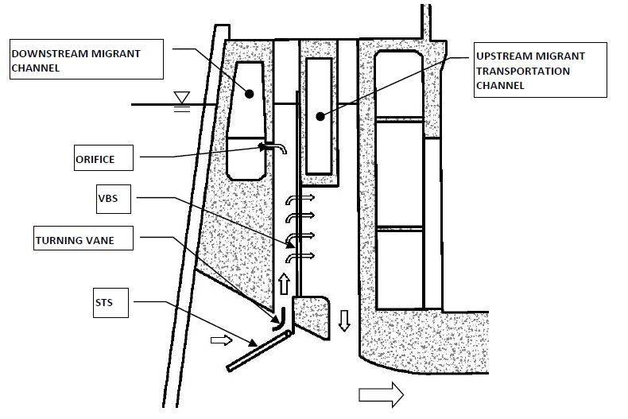
Gatewell and flow path

Slide 6
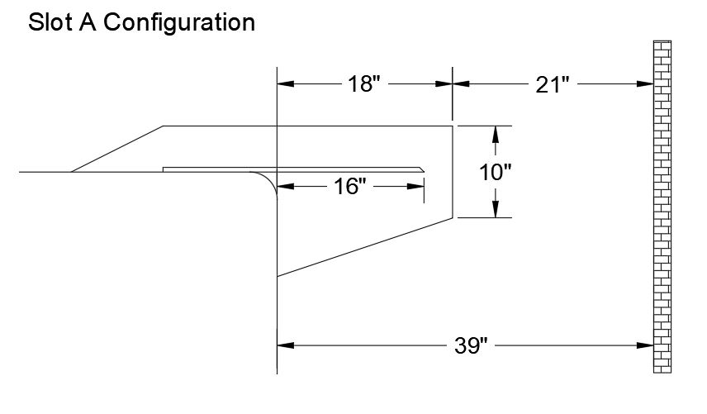
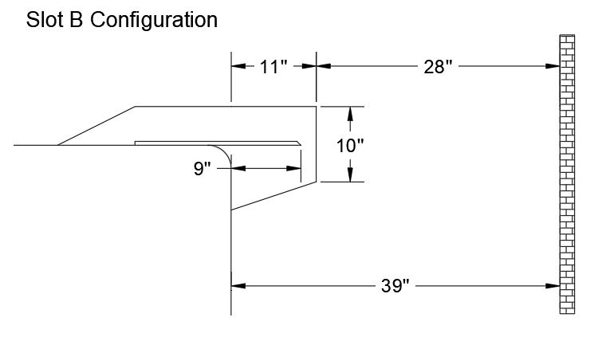
Dimensions
Corbels were designed with hand calculations and validated with CFD.

Slide 7
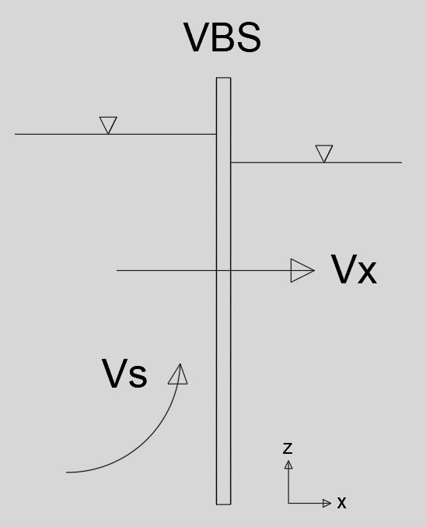
Velocity testing conclusions
Upper 1% Flow – 18 kcfs
Through-screen velocities (Vx) consistently trended higher than 2015.
Average VBS velocity criteria was met.
Uniform flow distribution criteria was not met for all gatewells in 2022 but was also not met for 2 of the 3 gatewells in 2015.
Gatewell turbulence also increased from 2015, but only marginally.
Middle 1% Flow – 15 kcfs
All criteria met for all slots.

Slide 8
pressure testing conclusions
Similar maximum pressures regardless of corbel (~0.5 ft increase above FBL).
~0.5 ft head drop across VBS when unit running.
No structural issues expected.
Conducted to ensure no adverse pressure loads on structural integrity of corbel.
Simulated maximum expected operational pressure load via a unit shut-down and start-up.

Slide 9
Additional considerations
Lower gatewell elevations displayed higher discrete Vx measurements but also higher sweeping velocities (Vs) 5-6 times greater than Vx.
Indicates fish will be swept up and away from lower elevations to higher elevations with milder Vx.
When a high Vs is present, it is difficult to accurately measure Vx.
Variations in Vx are to be expected.
Probe rotation/movement can’t be ruled out.
Outfitting PH2 with corbels would allow BPA full 1% efficiency range operations, providing release from the mid-1% operational restriction.
Updated FPP upper 1% tables means 2022 testing flows were greater than what flows BON expects to operate at under future conditions.
Implies slight reduction in Vx, and slight improvement to fish passage conditions.
Differences in PH2 unit operations between test years could have influenced forebay circulation and overall gatewell flow patterns.
Considering the numerous possible PH2 unit operation permutations, achieving acceptable hydraulic conditions across all gatewells, in all units, at all times, may be unrealistic.
Notes:
18,072 cfs = new FPP maximum. 2022 testing hovered around 18,200 cfs

Slide 10
Path forward
USACE held discussions with NMFS at District and Division level about acceptability of 2022 hydraulic testing results.
NMFS remains concerned about the hydraulic testing results but agreed outfitting PH2 with corbels per the existing contract is acceptable.
Additional Coordination with NMFS
Post-construction evaluation (juvenile monitoring facility?)
Adaptive management measures (operational restrictions, porosity plate configuration, etc)
Upper 1% specific operation
A Final Data Collection Report will be available December 2022.

Slide 11
Construction schedule
Construction to resume December 1, 2022.
“Priority units 1, 10, 11, and 18 will be scheduled for any necessary extended outages between December 1 and April 30.” (FPP, 2022)
Contractor and BON are coordinating sequencing details, dates below are tentative.
Unit No. | Start | Complete
11 | 12/1/22 | 1/16/23
18 | 1/30/23 | 3/28/23
17 | 4/3/23 | 5/8/23
16 | 5/15/23 | 6/26/23
14 | 7/3/23 | 8/14/23
13 | 8/21/23 | 10/2/23
12 | 10/9/23 | 11/20/23

